Slide 1

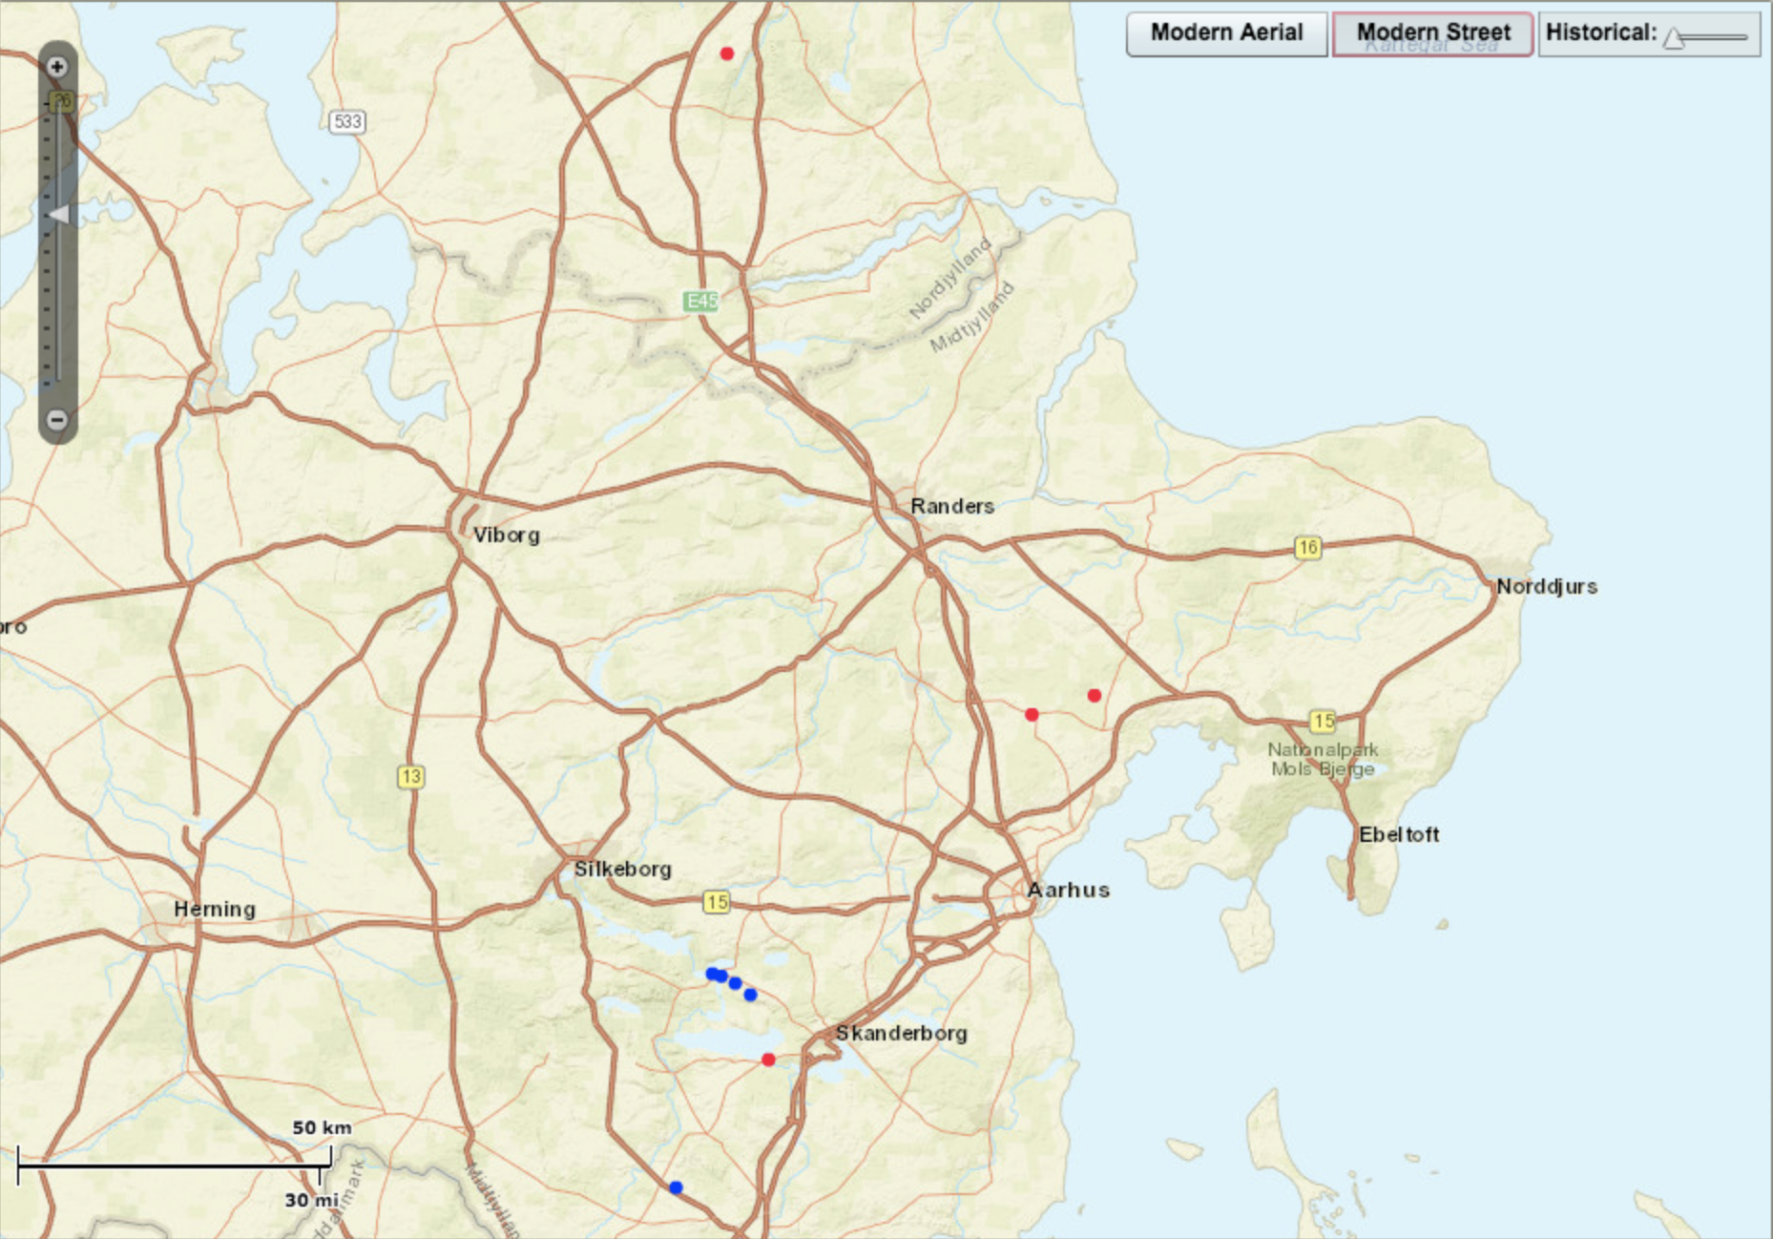


Danish Folklore |
The Evald Tang
Kristiansen Collection
Topic & Index Navigator
Tangherlini Indice
Animals
Insects
From
1899
To
1887
Associated Stories
150 – 1.02 – DSkv_0_11e
235 – 1.29 – DS_VI_970
150 – 1.02 – DSkv_0_11e
150 – 1.02 – DSkv_0_11e
150 – 1.02 – DSkv_0_11e
150 – 1.02 – DSkv_0_11e
Home
DSkv_011e

Slide 2
Topic & Index Navigator
Tangherlini Indice
Animals
Insects
From
1899
To
1887
Associated Stories
150 – 1.02 – DSkv_0_11e
235 – 1.29 – DS_VI_970
150 – 1.02 – DSkv_0_11e
150 – 1.02 – DSkv_0_11e
150 – 1.02 – DSkv_0_11e
150 – 1.02 – DSkv_0_11e

